Slide 1
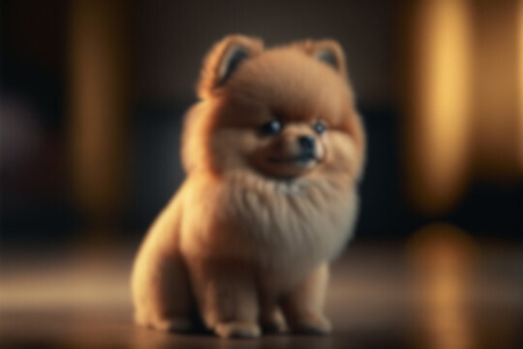
SHIVASHANKAR.M
FINAL PROJECT
01

Slide 2
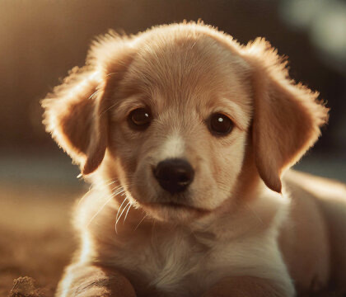
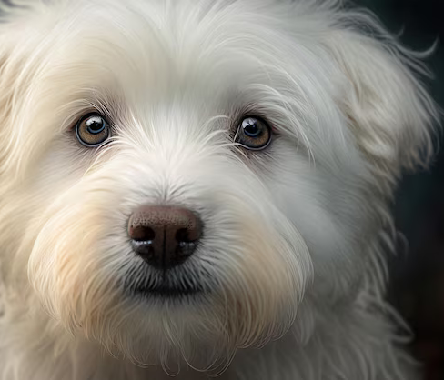
DOG IMAGE GENERATION
USING GAN
02

Slide 3
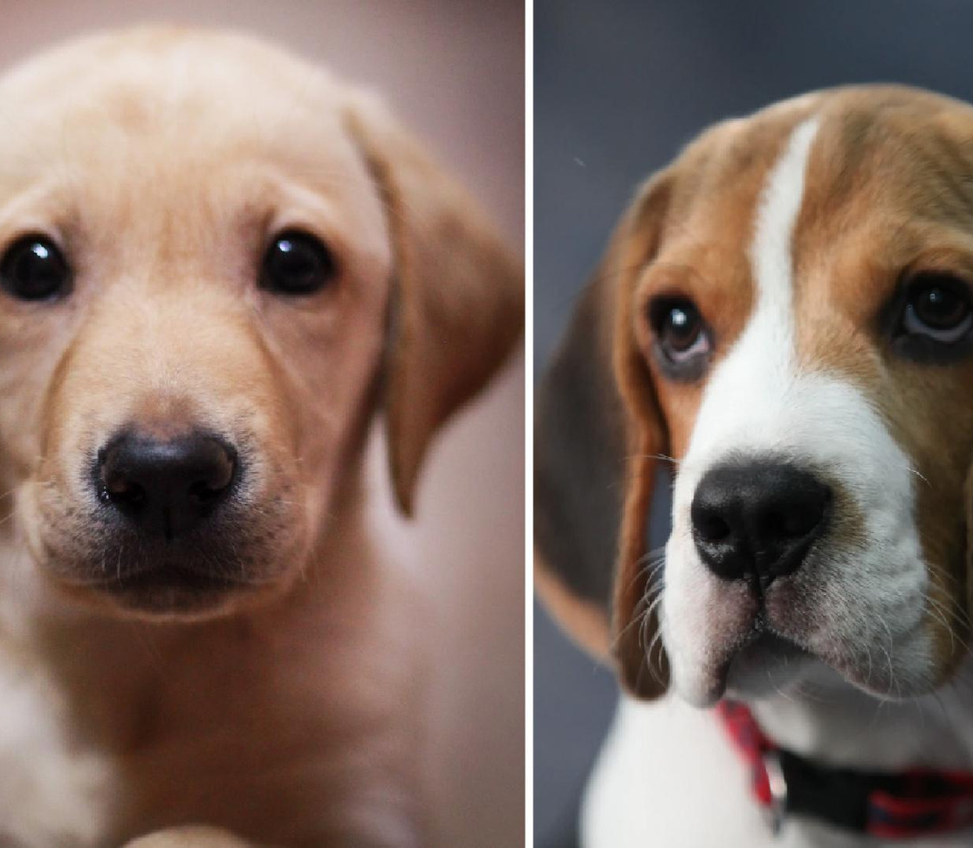
AGENDA
1. Introduction
• Brief overview of the project
• Importance of image generation in AI and creative applications
2. Background
• Explanation of Generative Adversarial Networks (GANs)
• Overview of GAN architecture (Generator and Discriminator
3. Dataset
• Description of the dataset used for training (size, source, diversity)
• Importance of high-quality training data in GAN-based image generation
4. Evaluation
• Metrics used for evaluating the generated images (e.g., Inception Score, FID Score)
• Human evaluation: feedback from observers on the realism of generated images
5. Results
• Presentation of generated dog images
• Comparison with real dog images
• Discussion on the quality and diversity of generated images
6.Challenges and Limitations
• Challenges encountered during training or evaluation
• Limitations of the current approach (e.g., potential biases, overfitting)
7.Conclusion
• Summary of key findings and achievements
• Implications of the project in AI, computer vision, and creative applications
03

Slide 4
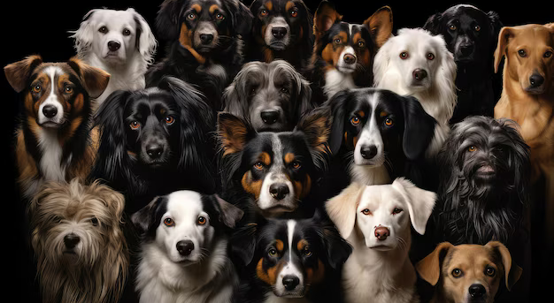
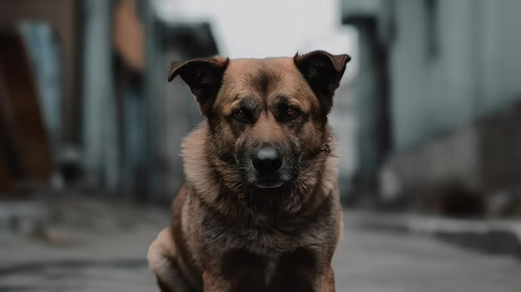
PROBLEM
STATEMENT
Generator:
Discriminator
This network takes random noise as input and generates data samples, in this case, dog images. Initially, its output is random noise, but through training, it learns to generate images that increasingly resemble real dog images.
This network tries to distinguish between real cat images and fake images generated by the generator. It's trained on a dataset of real dog images and learns to differentiate between real and generated images.
04

Slide 5
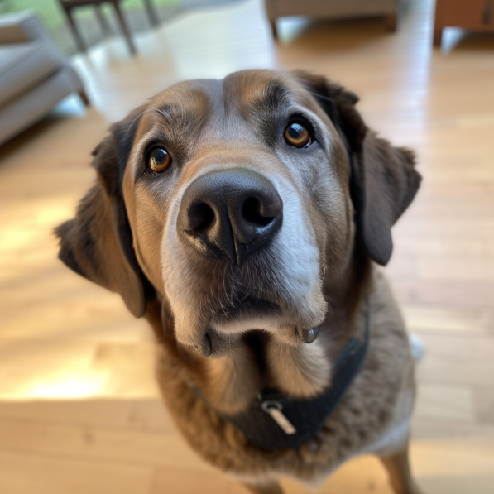
PROJECT OVERVIEW
Develop a GAN model to generate realistic dog images from random noise, training the generator to produce indistinguishable images while the discriminator learns to differentiate between real and fake ones. Key components include dataset acquisition, generator and discriminator network design, training procedure, evaluation metrics, hyperparameter tuning, and deliverables encompassing the trained model, documentation, and optionally, a deployed application. Success is defined by the model's ability to produce high-quality, diverse dog images consistently.
05

Slide 6
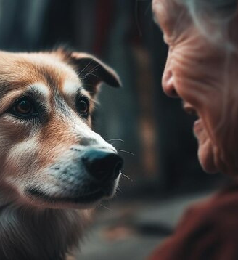
WHO ARE THE END USER
01
Artists and Designers: Seeking inspiration or reference images for creative projects involving dog.
02
Content Creators: Looking for dog images to enhance their social media posts, blogs, or websites.
03
Cat Enthusiasts: Interested in collecting or sharing dog images for personal enjoyment or community engagement.
04
Developers: Integrating the generated dog images into applications or software products for various purposes, such as gaming, virtual environments, or data augmentation in machine learning tasks.
06

Slide 7
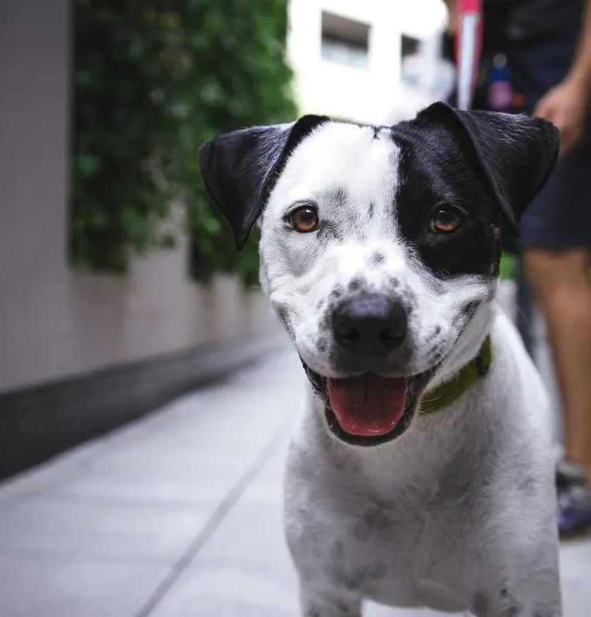
YOUR SOLUTION AND ITS VALUE PROPOSITION
Our solution offers a Generative Adversarial Network (GAN) model capable of generating realistic dog images from random noise. By harnessing advanced machine learning techniques, our model produces high-quality and diverse dog images, catering to various end users such as artists, designers, content creators, dog enthusiasts, educators, and developers. This solution streamlines the process of acquiring dog images for creative projects, social media content, educational materials, and software applications. Its value proposition lies in providing a reliable and efficient means of accessing visually appealing dog imagery, enhancing creativity, engagement, and functionality across multiple domains.
07

Slide 8
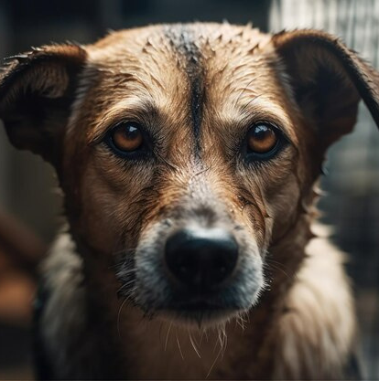
THE WOW FACTOR:
Our GAN-based dog image generator isn't just about creating static images—it's about unlocking endless possibilities in the realm of dog imagery. With our solution, users can marvel at the stunning realism and diversity of the generated dog images, each one a unique masterpiece crafted from nothing but random noise. From adorable kittens to majestic felines, our model transcends the limitations of traditional image generation, captivating users with its ability to produce lifelike dog portraits on demand. Whether you're an artist seeking inspiration, a developer powering immersive experiences, or simply a dog lover in awe of technology's creative prowess, our solution promises to evoke a sense of wonder and delight with every generated image.
08

Slide 9
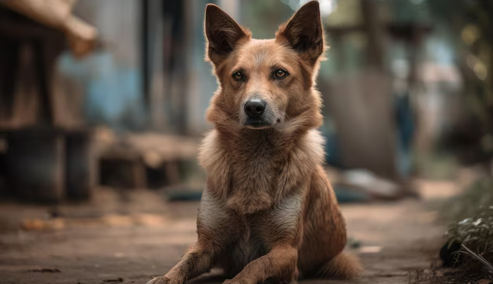
MODELING APPROACH
Utilizing a GAN framework, our model employs deep CNNs for the generator and discriminator networks, enabling the generation of high-resolution dog images. The generator progressively transforms random noise into realistic dog images, while the discriminator learns to distinguish between real and generated images. Training involves adversarial optimization, iteratively updating both networks to achieve image fidelity. We evaluate performance using FID and qualitative assessments, fine-tuning with techniques like progressive growing. Once trained, our model can be easily deployed for seamless dog image generation in various environments.
09

Slide 10
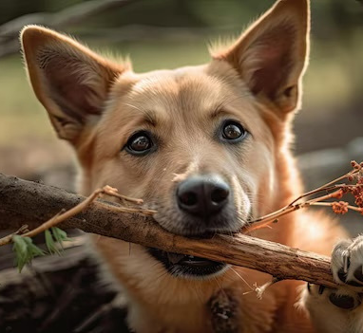
CONCLUSION
Utilizing a GAN framework, our model employs deep CNNs for the generator and discriminator networks, enabling the generation of high-resolution dog images. The generator progressively transforms random noise into realistic dog images, while the discriminator learns to distinguish between real and generated images. Training involves adversarial optimization, iteratively updating both networks to achieve image fidelity. We evaluate performance using FID and qualitative assessments, fine-tuning with techniques like progressive growing. Once trained, our model can be easily deployed for seamless dog image generation in various environments.
This is one of generated images of dog
10

